Slide 1

Green Pace
Security Policy Presentation
Developer: Raymond Aponte
Notes:
Hello, my name is Raymond Aponte, and this is my Security Policy Presentation on behalf of Green Pace.

Slide 2

OVERVIEW: DEFENSE IN DEPTH
This policy defines the core security principles; C/C++ coding standards; authorization, authentication, and auditing standards; and data encryption standards.
It will be used to enforce defense in depth because if one security layer is breached, there are standards/policies put in place in other layers to prevent access to critical assets.
Notes:
Let’s begin with an overview of Defense-in-Depth.
Defense in depth is a security approach which implements multi-layer defense across the whole cybersecurity infrastructure in an attempt to prevent hackers from gaining access to private assets
This security policy defines the core security principles; C and C++ coding standards; authorization, authentication, and auditing standards; and data encryption standards.
It will be used to enforce defense in depth because if one security layer is breached, there are standards or policies put in place in other layers to prevent access to critical assets.

Slide 3
THREATS MATRIX
Likelihood - that a flaw introduced by ignoring the rule can lead to an exploitable vulnerability (Ballman & Svoboda, 2017).
Priority – The level of importance a specific rule carries
Likely STR02-C STR51-CPP MEM52-CPP MEM53-CPP ERR55-CPP ERR56-CPP | Priority DCL50-CPP STR02-C STR51-CPP MEM52-CPP MEM53-CPP
Low priority PRE31-C | Unlikely PRE31-C
Notes:
This threat matrix is broken into four parts: Likely, Unlikely, Priority, and Low Priority.
Each part contains coding standards that pertain to each.
According to Ballman and Svoboda (2017) of Confluence, likelihood in this instance refers to the likelihood that a flaw introduced by ignoring the rule specified in the matrix can lead to an exploitable vulnerability.
Priority is how important a specific rule is.

Slide 4
10 PRINCIPLES
Validate Input Data
DCL50-CPP, STR51-CPP, STR02-C, MEM52-CPP, STR52-CPP
Heed Compiler Warnings
DCL50-CPP, MSC52-CPP, STR51-CPP, MEM53-CPP, ERR56-CPP
Architect and Design for Security Policies
PRE31-C
Keep it Simple
ERR55-CPP, STR52-CPP
Default Deny
STR02-C, MEM53-CPP
Adhere to the Principle of Least Privilege
STR02-C, MEM53-CPP
Sanitize Data Sent to Other Systems
STR02-C
Practice Defense in Depth
ERR56-CPP
Use Effective Quality Assurance Techniques
MSC52-CPP, STR51-CPP, MEM53-CPP, PRE31-C, ERR55-CPP, MEM52-CPP, STR52-CPP
Adopt a Secure Coding Standard
All rules are taken from the SEI CERT C/C++ Coding Standards
Notes:
Presented here are the ten coding principles which include: Validate Input Data; Heed Compiler Warnings; Architect and Design for Security Policies; Keep it Simple; Default Deny; Adhere to the Principles of Least Privilege; Sanitize Data Sent to Other Systems; Practice Defense in Depth; Use Effective Quality Assurance Techniques; and Adopt a Secure Coding Standard.
Each principle includes a list of the coding standards presented in this security policy that pertain to that principle.

Slide 5
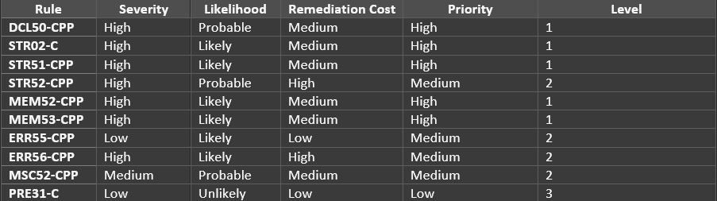
CODING STANDARDS
DCL50-CPP: Do not define a C-style variadic function
MSC52-CPP: Value-returning functions must return a value from all exit paths
STR51-CPP: Do not attempt to create a std::string from a null pointer
STR52-CPP: Use valid references, pointers, and iterators to reference elements of a basic_string
STR02-C: Sanitize data passed to complex subsystems
MEM53-CPP: Explicitly construct and destruct objects when manually managing object lifetime
MEM52-CPP: Detect and handle memory allocation errors
PRE31-C: Avoid side effects in arguments to unsafe macros
ERR56-CPP: Guarantee exception safety
ERR55-CPP: Honor exception specifications
Notes:
Listed here are the 10 coding standards.
DCL50-CPP: Do not define a C-style variadic function
MSC52-CPP: Value-returning functions must return a value from all exit paths
STR51-CPP: Do not attempt to create a std::string from a null pointer
STR52-CPP: Use valid references, pointers, and iterators to reference elements of a basic_string
STR02-C: Sanitize data passed to complex subsystems
MEM53-CPP: Explicitly construct and destruct objects when manually managing object lifetime
MEM52-CPP: Detect and handle memory allocation errors
PRE31-C: Avoid side effects in arguments to unsafe macros
ERR56-CPP: Guarantee exception safety
And ERR55-CPP: Honor exception specifications
Included to the right of the list is a table ranking each rule based on its placement in the SEI CERT C/C++ Coding Standards. However, each header provides another way for these rules to be ranked such as on severity or likelihood.

Slide 6
ENCRYPTION POLICIES
Encryption in rest
Full disk encryption, data loss prevention solutions (DLPs)
Encryption at flight
Firewalls, authentication, automation, TLS, certificates, DLPs
Encryption in use
Authorization, authentication
Notes:
These are the encryption policies that will be enforced including encryption in rest, encryption at flight, and encryption in use.
Encryption in rest is the encryption of data that is inactive as it is not moving between networks or devices such as archived data in a database
The policy for encryption of data in rest includes incorporating full disk encryption to ensure hackers cannot access data on a lost drive and implementing data loss prevention solutions (DLPs). With DLPs, we can search and find sensitive data and block access to that data from certain users if a breach occurs.
Encryption at flight is the encryption of data that is moving from one location to another such as when it is transmitted over a network.
The policy for encryption of data at flight includes the incorporation of firewalls and authentication, implementing automation to block malicious files and encrypt data before it is in transit, using TLS for https on all connections, and using certificates signed by a Certificate Authority so that our public key is verified by a trusted source. DLPs can also be used to scan emails and attachments to identify leaks.
Encryption in use is the encryption of data that is being accessed and processed by users.
The policy for encryption of data in use emphasizes that the protection of data beginning in pre-production and lasting throughout production. Authorization and authentication are extremely important so that only authorized individuals have permission to access data that is strictly necessary for them to complete their jobs.

Slide 7
TRIPLE-A POLICIES
Authentication
User’s authentication credentials successfully match credentials stored in our database
Monitoring of all users is the responsibility of system administrators
Authorization
Once a user is authenticated, they shall only be allowed the activities, services, and resources that they are permitted/authorized to use based on their user level of access.
Accounting
Administrators need to see statistics for logging sessions, session duration, files accessed by users, and data both sent and received.
Administrators need to see who logged in, the actions they performed, and what time they were performed.
Notes:
These are the policies that revolve around the implementation of Triple A: authentication, authorization, and accounting.
Authentication refers to ensuring a user is who they say they are; only users who enter valid credentials during user login should have access to our system.
This is accomplished when the user’s authentication credentials successfully match credentials stored in our database. The addition of new users, deletion of current users, and monitoring of all users is the responsibility of system administrators. Authentication must be prioritized during all stages of pre-production and is vital to be monitored during production.
Authorization is especially important after authentication.
Once a user is authenticated, they shall only be allowed the activities, services, and resources that they are permitted/authorized to use based on their user level of access. For example, administrators may have more privileged access, but only to what is necessary to complete their jobs. Authorization must also be prioritized during all stages of pre-production and monitored during production.
Accounting is the measurement of resources that users consume during their network access to our application.
Administrators need to see statistics for logging sessions, session duration, files accessed by users, and data both sent and received. In addition, administrators need to see who logged in, the actions they performed, and what time they were performed. Accounting should take place throughout the entirety of the pre-production and production cycle. This is the only way to ensure a proper response to any security breach and the stabilization of our system if an attack were to occur.

Slide 8
Unit Testing
The following are examples of unit testing with GoogleTest to ensure code compliance.
Notes:
Unit testing is testing small pieces of code at a time to ensure code security beginning early in the development process. These tests should also be carried out often.
The following are examples of unit testing with GoogleTest to ensure code compliance.

Slide 9
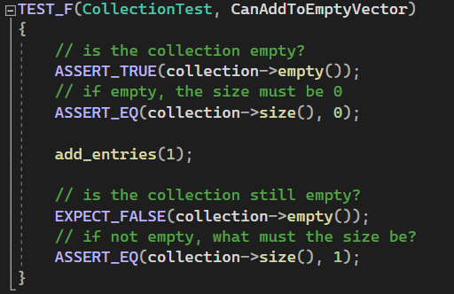
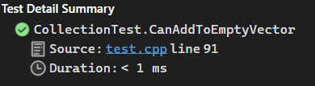
Can we add a single value to an empty collection?
Notes:
This positive unit test answers the question, “Can we add a single value to an empty collection?”
The test verifies that the collection is empty, and the size of the collection is zero. After one entry is added, the test verifies that the collection is no longer empty and its size is one.

Slide 10
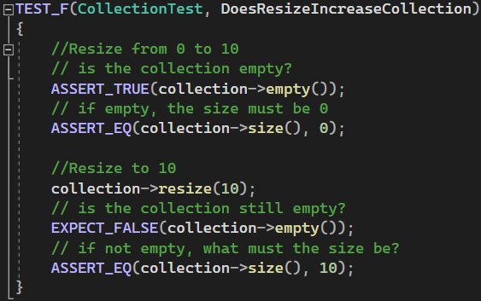
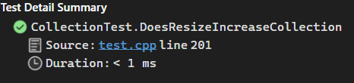
Does the resize method increase the size of the collection?
Notes:
This positive unit test answers the question, “Does the resize method increase the size of the collection?”
The test verifies that the collection is empty, and the size of the collection is zero. After resize is called with 10 entries, the test verifies that the collection is no longer empty and its size is 10.

Slide 11
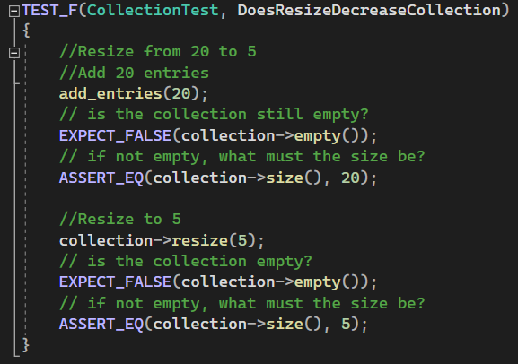
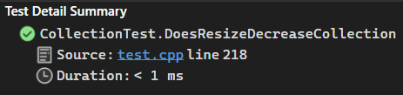
Does the resize method decrease the size of the collection?
Notes:
This positive unit test answers the question, “Does the resize method decrease the size of the collection?”
First, 20 entries are added to the collection. After this, the test verifies that the collection is no longer empty and its size is 20. Next, resize is called with 5 entries. The test verifies that the collection is not empty once again and that its size has been decreased to 5.

Slide 12
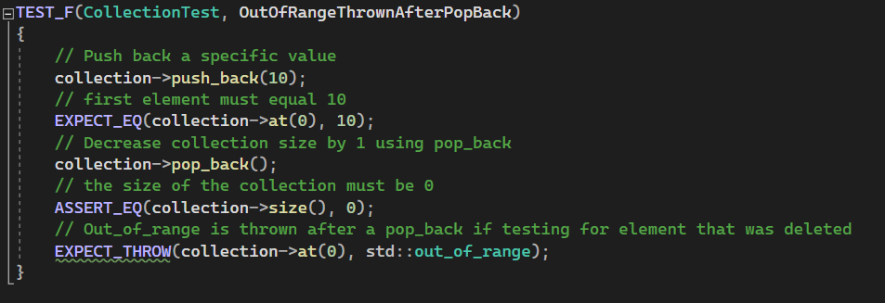
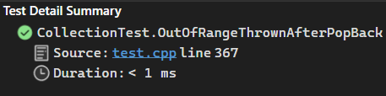
Will an out-of-range exception be accurately thrown when testing the previous size of the collection after implementing a pop_back?
Notes:
This negative unit test answers the question, “Will an out-of-range exception be accurately thrown when testing the previous size of the collection after implementing a pop_back?”
First, an element with the value 10 is added to the collection using push_back. Next, the test ensures that the first value is now 10. After this, pop_back is implemented to remove that element. The test then ensures that the size of the collection is now zero and an out-of-range exception is thrown if we try to access the first element again.

Slide 13

AUTOMATION SUMMARY
Notes:
Next is the Automation Summary which includes a diagram of the DevSecOps pipeline.
The purpose of DevSecOps is to bake security into each stage of both pre-production and production. With this model, security is brought to the forefront and is not an afterthought.
Stages will contain security automation for the enforcement and compliance of our standards.

Slide 14
TOOLS
Assess and Plan
Design
Test Driven Development incorporating unit testing
Build
Compiler
Verify and Test
Vulnerability scanning with automation tools listed per standard. Ex.) Cppchecker
Transition and Health Check
Penetration testing to uncover vulnerabilities
Monitor and Detect
Intrusion detection, keeping logs of user sessions, event alerts, DLPs
Respond
Turn off services and roll back when detection discovers a problem
Maintain and Stabilize
Notes:
These are the stages that will contain security automation and the tools that reside in the flow of automation.
The Design stage includes test driven development such as incorporating unit testing
The Build stage includes the compiler
The Verify and Test stage includes vulnerability scanning with automation tools listed per standard. An example would be Cppchecker.
The Transition and Health Check stage includes penetration testing to uncover vulnerabilities
The Monitor and Detect stage includes intrusion detection, keeping automated logs of user sessions, event alerts, and DLPs
Lastly, the Respond stage includes turning off services and roll back when a problem is discovered in detection

Slide 15
RISKS AND BENEFITS
Act Now
Risks - Implementing a new strategy may take more time than anticipated, and audits may still turn up a sizeable number of issues if this strategy is not implemented correctly.
Benefits – We can deliver more reliable software at a quicker pace, save time and money as flaws can be discovered in earlier stages of development, our team will be empowered to put security first, and tracking problems should be much easier with automation integrated.
Wait
Risks – Reputation may be tarnished if a security breach or leak occurs, time may be wasted trying to fix code that should have been in a more secure state from the start, and money will be lost putting in more time to mitigate issues reactively.
Benefits – Development may be quicker at first before issues are eventually discovered during production.
Notes:
These are the risks and benefits of either implementing this security policy now or deciding to wait.
Risks of acting now: Implementing a new strategy may take more time than anticipated, and audits may still turn up a sizeable number of issues if this strategy is not implemented correctly.
Benefits of acting now: We can deliver more reliable software at a quicker pace, save time and money as flaws can be discovered in earlier stages of development, our team will be empowered to put security first, and tracking problems should be much easier with automation integrated.
Risks of waiting: Our reputation may be tarnished if a security breach or leak occurs, time may be wasted trying to fix code that should have been in a more secure state from the start, and money will be lost putting in more time to mitigate issues reactively.
Benefits of waiting: Development may be quicker at first before issues are eventually discovered during production.

Slide 16
RECOMMENDATIONS
Gaps
Security policies must be updated as they become outdated.
Staff training in the implementation of this new policy must be prioritized as strictly enforcing this policy is not enough.
We need a secure system to handle new hires and terminated employees beyond manual addition and deletion.
Former Expedia IT employee hack in 2016 (Egan, 2016).
Notes:
For recommendations, I have done a gap analysis of the existing security policy for gaps that still need to be addressed.
First, security policies must be updated as they become outdated.
Staff training in the implementation of this new policy must be prioritized as strictly enforcing this policy is not enough. Once training is complete in a timely fashion, the staff is responsible for following this policy.
We need a secure system to handle new hires and terminated employees beyond manual addition and deletion.
An example of this is in 2016, a former Expedia IT employee was able to hack his previous employer’s senior executives and gained insider information to profit from stock trades (Egan, 2016).
This was only accomplished because the hacker still had a company-issued laptop that had not been returned or tracked (Egan, 2016).

Slide 17
CONCLUSION
Standards stated in this security policy that can be implemented to prevent and/or resolve issues such as that of the ex-Expedia employee include:
Defense in Depth
Triple A
Encryption policies
An additional standard that can be implemented is Zero Trust
Zero Trust refers to a security approach where there is continuous verification of trust across users, applications, and devices to ensure that only required access is granted to trusted sources (Kueh, 2020).
To conclude, implementing our security policy is a good start today, but thinking about ways to improve security is key to ensuring the security of our programs and system in the future.
Notes:
Standards stated in this security policy that can be implemented to prevent and/or resolve issues such as that of the ex-Expedia employee include:
Defense in Depth
Triple A
Encryption policies
An additional standard that can be implemented is Zero Trust
Zero Trust refers to a security approach where there is continuous verification of trust across users, applications, and devices to ensure that only required access is granted to trusted sources (Kueh, 2020).
To conclude, implementing our security policy is a good start today, but thinking about ways to improve security is key to ensuring the security of our programs and system in the future.

Slide 18
REFERENCES
Argintaru, D. (2021, July 22). Data Encryption - Data at rest vs in transit vs in use options. Mimecast. Retrieved December 10, 2022, from https://www.mimecast.com/blog/data-in-transit-vs-motion-vs-rest/
Ballman, A., & Svoboda, D. (2021, April 14). How this coding standard is organized. Confluence. Retrieved December 17, 2022, from https://wiki.sei.cmu.edu/confluence/display/cplusplus/How+this+Coding+Standard+Is+Organized#Howt hisCodingStandardIsOrganized-RiskAssessment
Egan, M. (2016, December 6). Expedia it guy made $300,000 by hacking own execs. CNN Business. Retrieved December 18, 2022, from https://money.cnn.com/2016/12/05/technology/expedia-hack-insider- trading-sec/index.html
Kueh, T. (2020, January 15). A practical guide to zero-trust security. Threatpost. Retrieved December 16, 2022, from https://threatpost.com/practical-guide-zero-trust-security/151912/
Mylonas, L. (2018, November 27). What is AAA Security? an introduction to authentication, Authorisation and Accounting. Codebots. Retrieved December 10, 2022, from https://codebots.com/application- security/aaa-security-an-introduction-to-authentication-authorisation-accounting
OpsCompass Staff. (2015, July 10). Are you encrypting your data-in-flight? if not, you should be. OpsCompass. Retrieved December 10, 2022, from https://opscompass.com/resources/blog/are-you-encrypting-your- data-in-flight-if-not-you-should-be/
Notes:
Thank you.

